Slide 1

WIPRO NGA Program – 25SUB4505_5G Developer
Capstone Project Presentation – 13th Feb and 14th Feb 2026
TEST 7: CHANNEL CODING
Presented by - Vinayak Majhi - 58618
Harsh Prasad – 58620
Diyanisha Dey - 58621
Keshav Janghala - 58625
Diptendra Maity - 58633
www.rpsconsulting.in

Slide 2
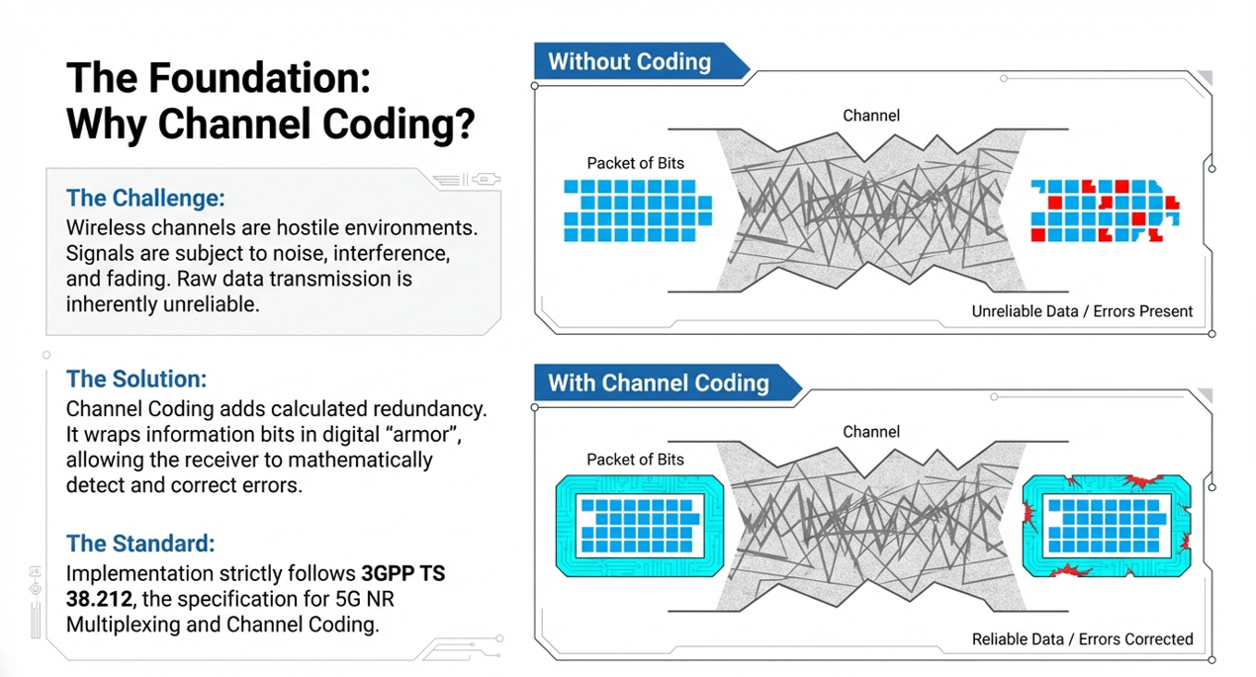

2024 - RPS Consulting all rights reserved

Slide 3
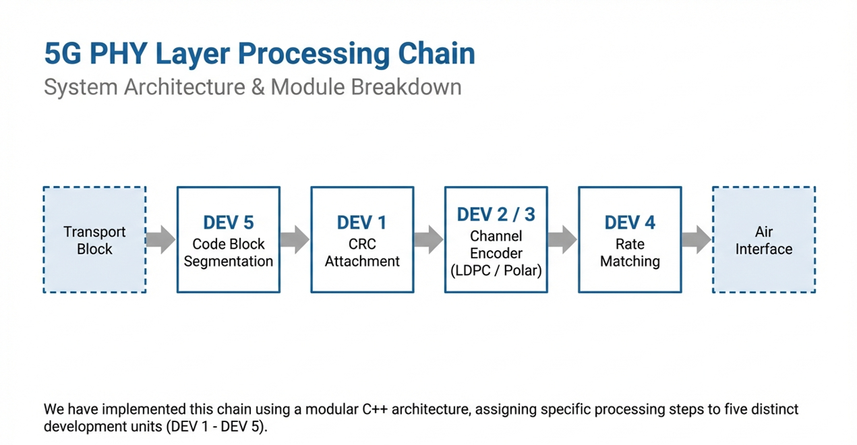
2024 - RPS Consulting all rights reserved

Slide 4
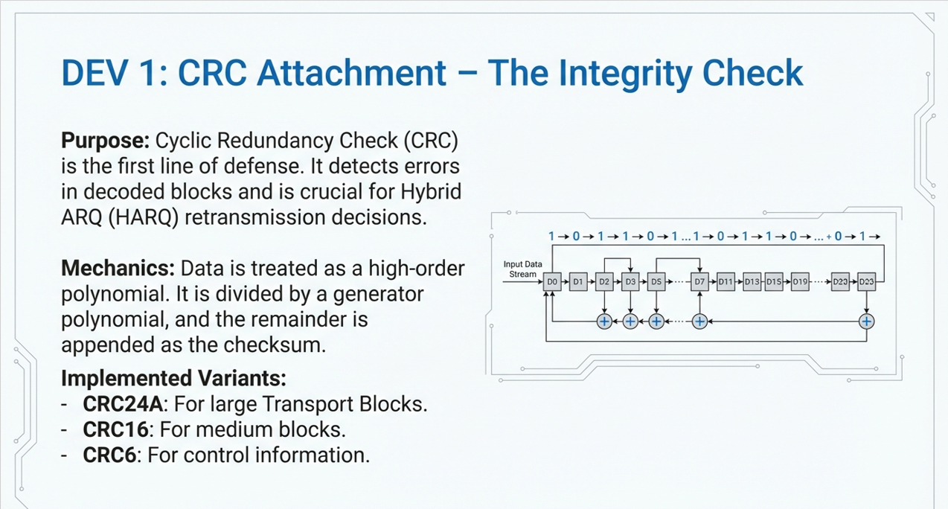
2024 - RPS Consulting all rights reserved

Slide 5
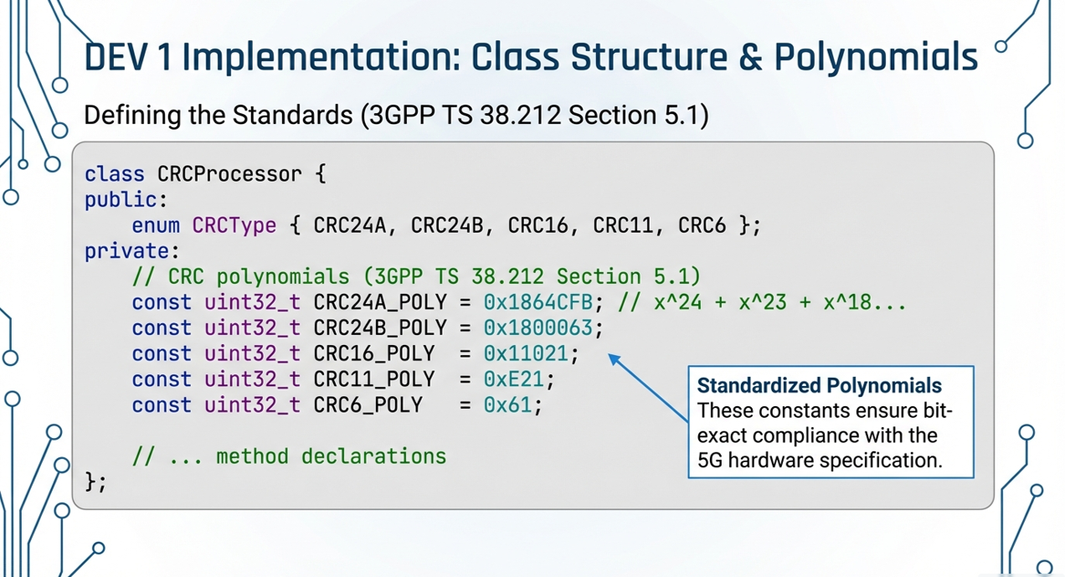
2024 - RPS Consulting all rights reserved

Slide 6
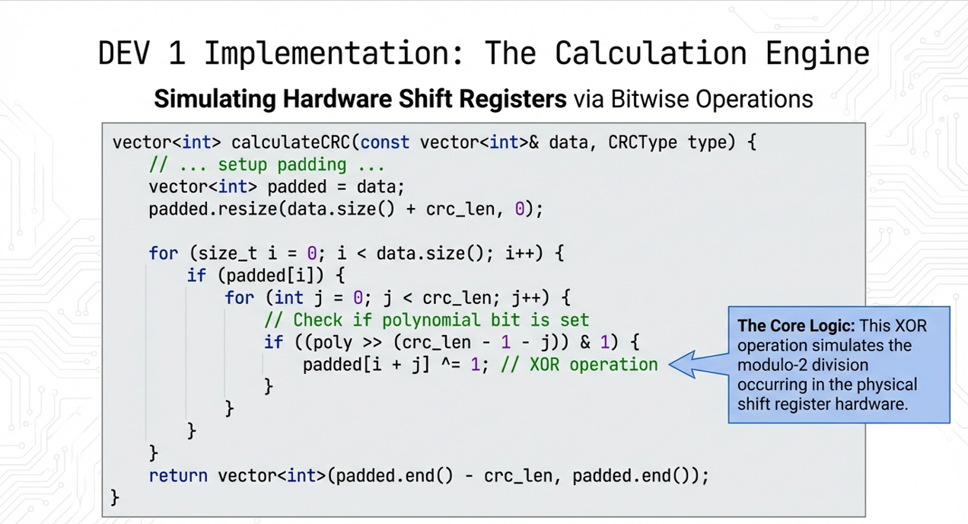
2024 - RPS Consulting all rights reserved

Slide 7
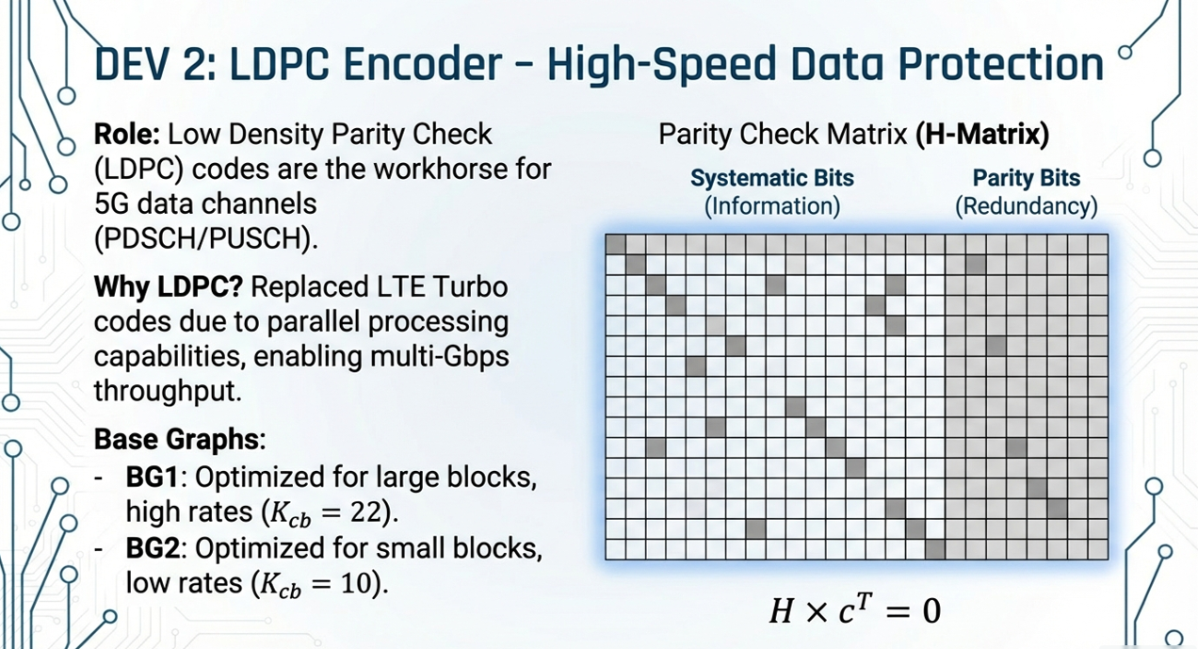
2024 - RPS Consulting all rights reserved

Slide 8
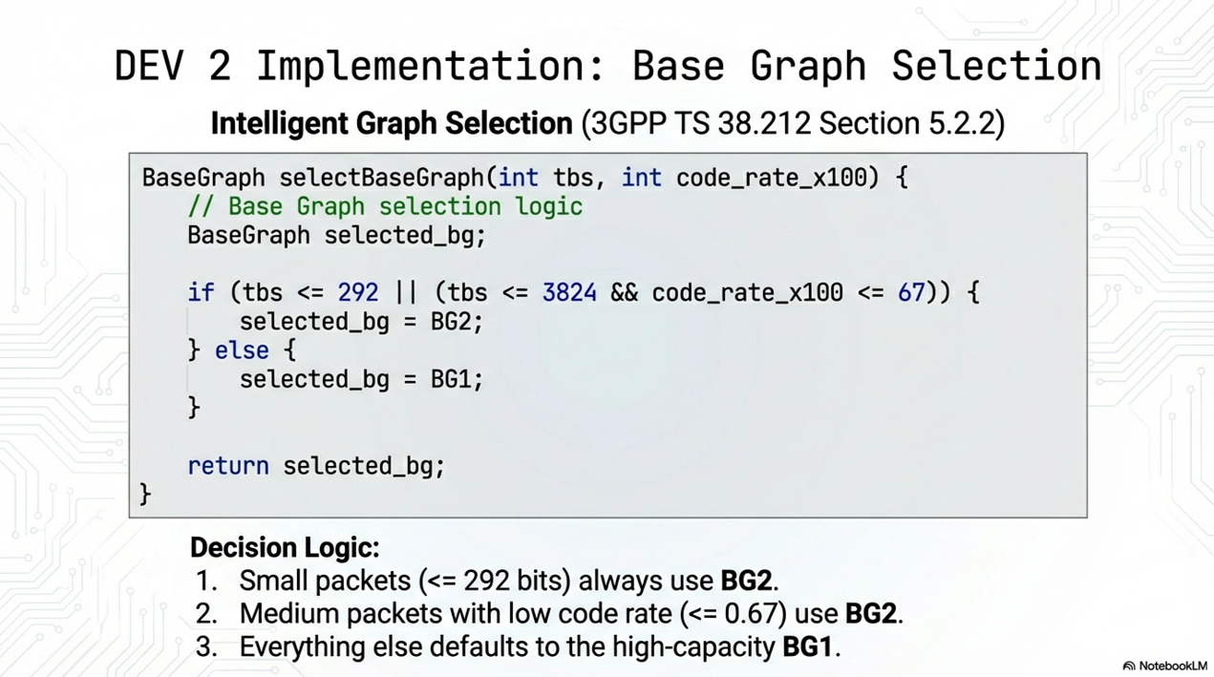
2024 - RPS Consulting all rights reserved

Slide 9
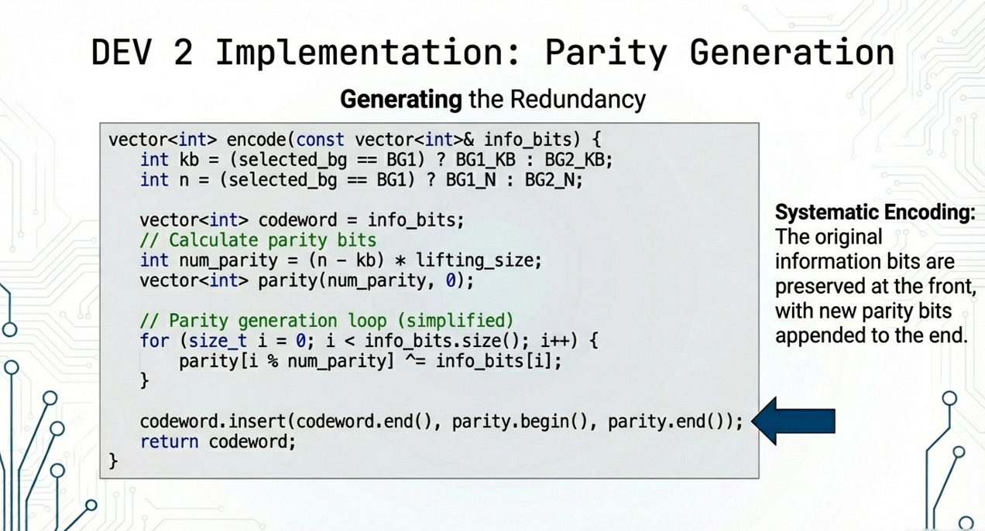
2024 - RPS Consulting all rights reserved

Slide 10
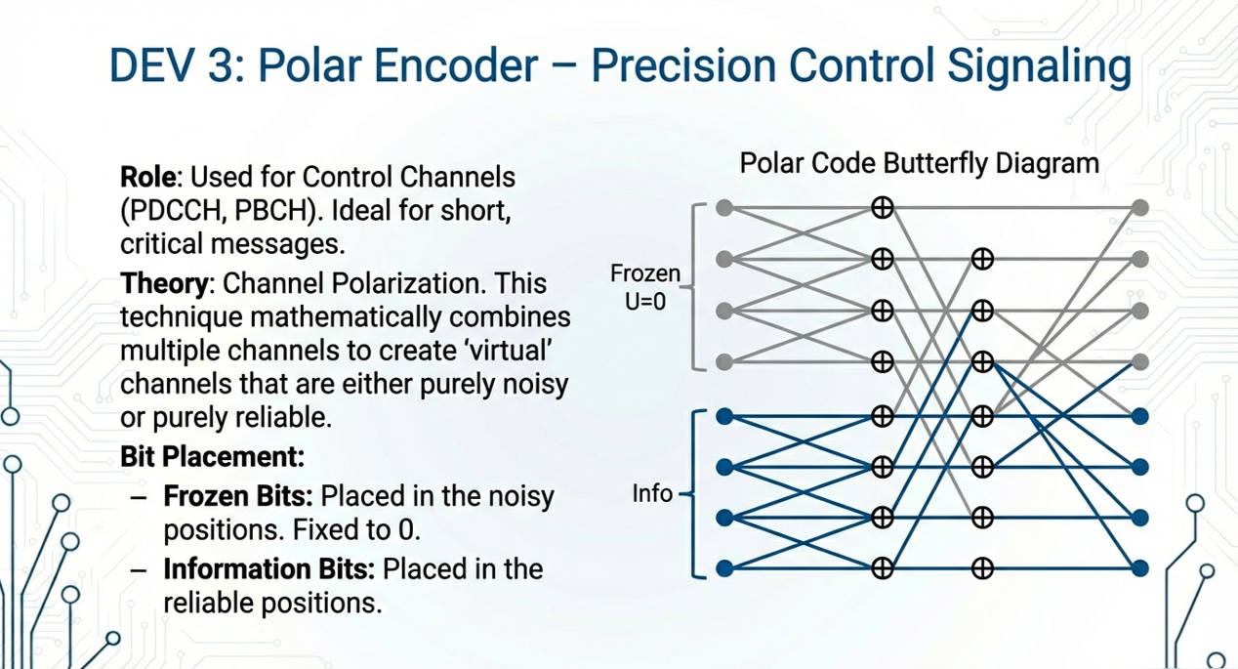
2024 - RPS Consulting all rights reserved

Slide 11
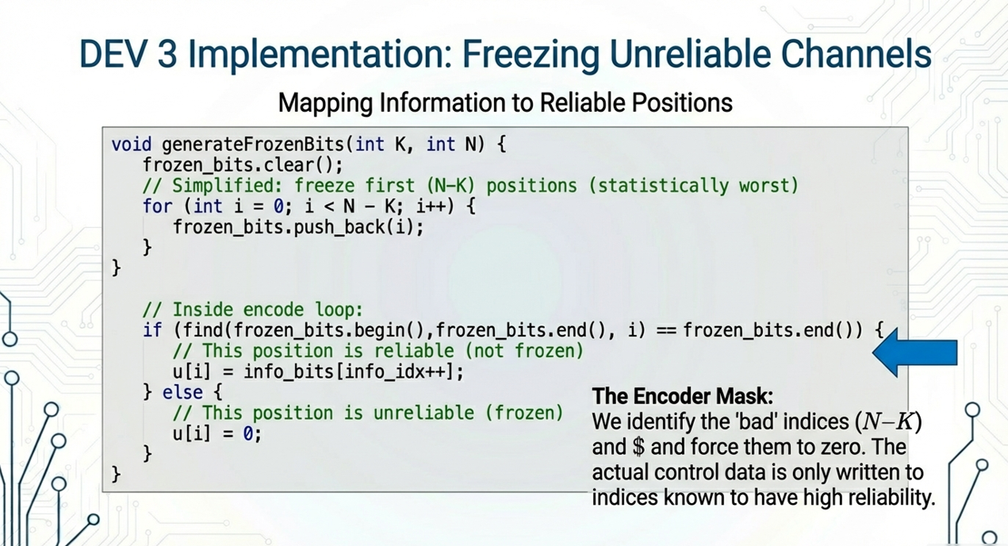
2024 - RPS Consulting all rights reserved

Slide 12
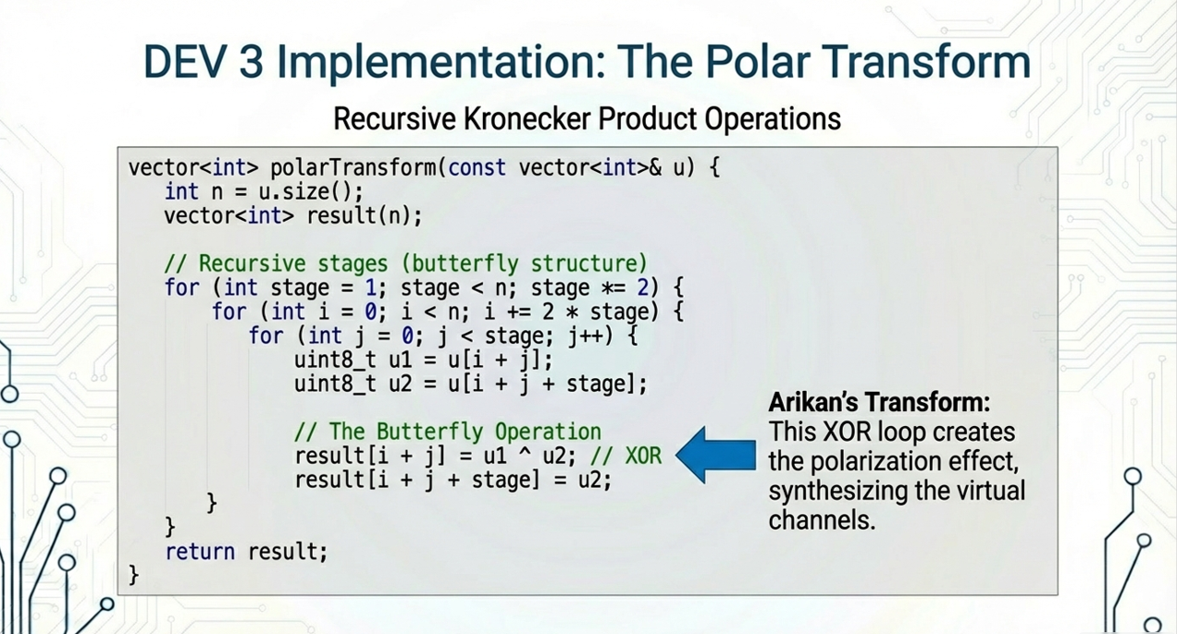
2024 - RPS Consulting all rights reserved

Slide 13
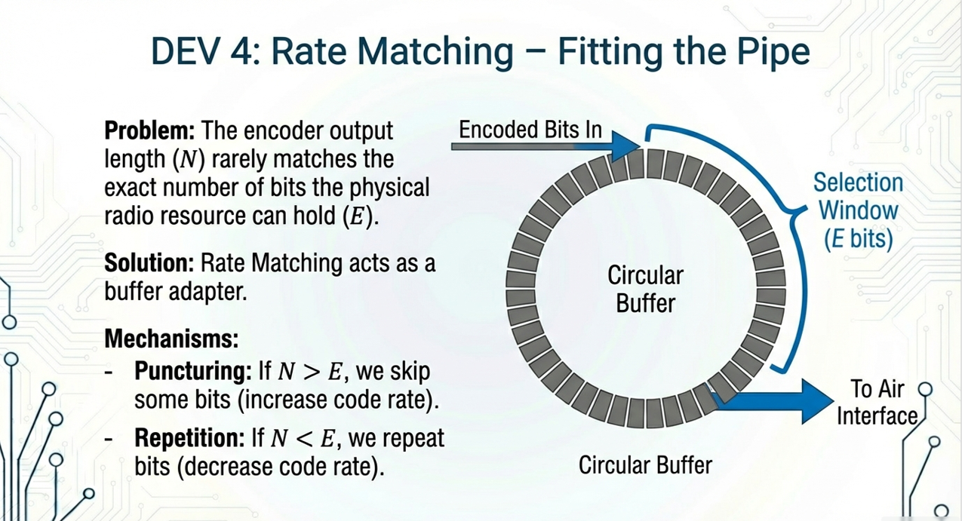
2024 - RPS Consulting all rights reserved

Slide 14
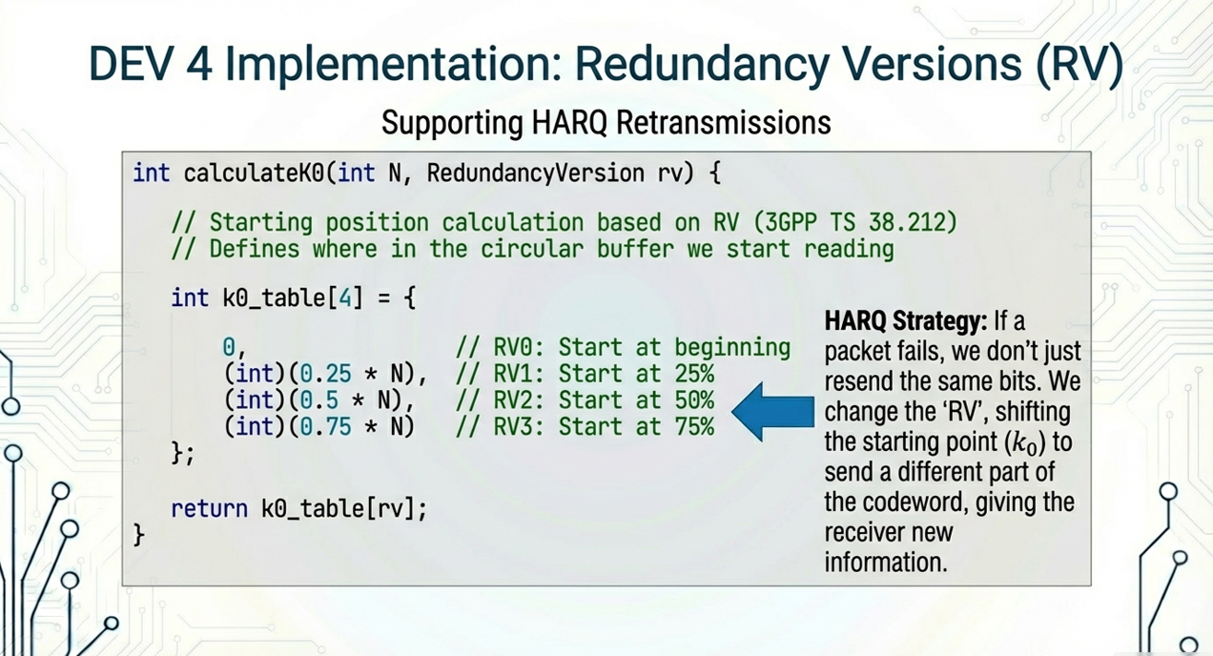
2024 - RPS Consulting all rights reserved

Slide 15
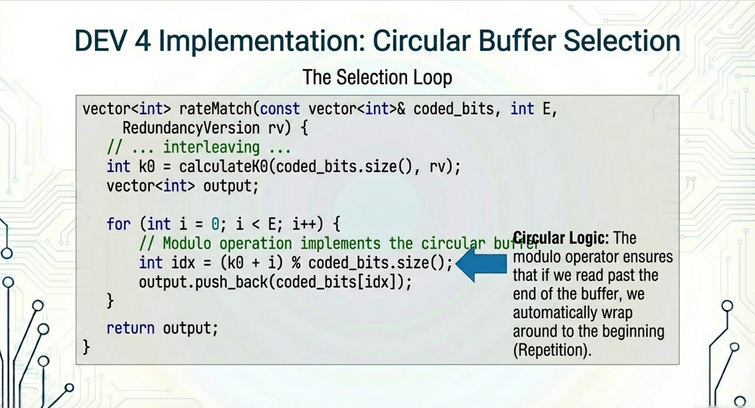
2024 - RPS Consulting all rights reserved

Slide 16
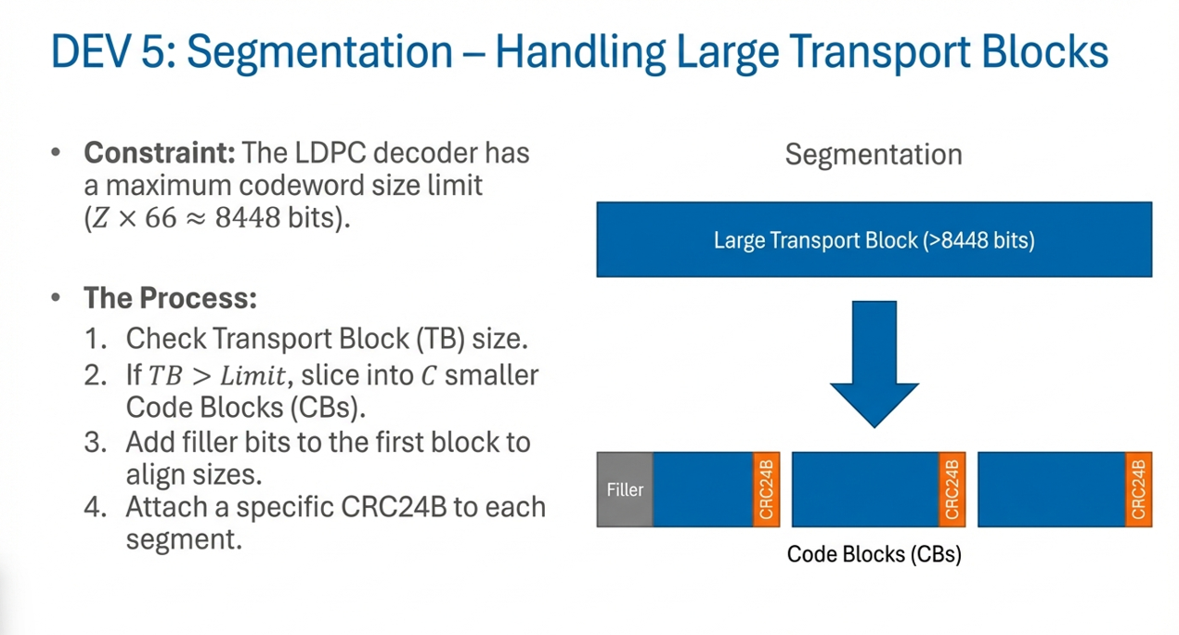
2024 - RPS Consulting all rights reserved

Slide 17
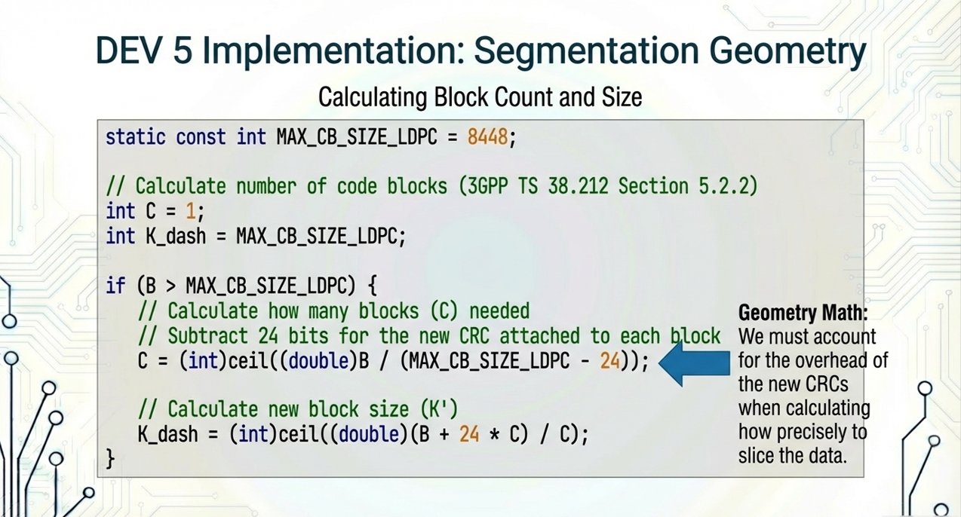
2024 - RPS Consulting all rights reserved

Slide 18
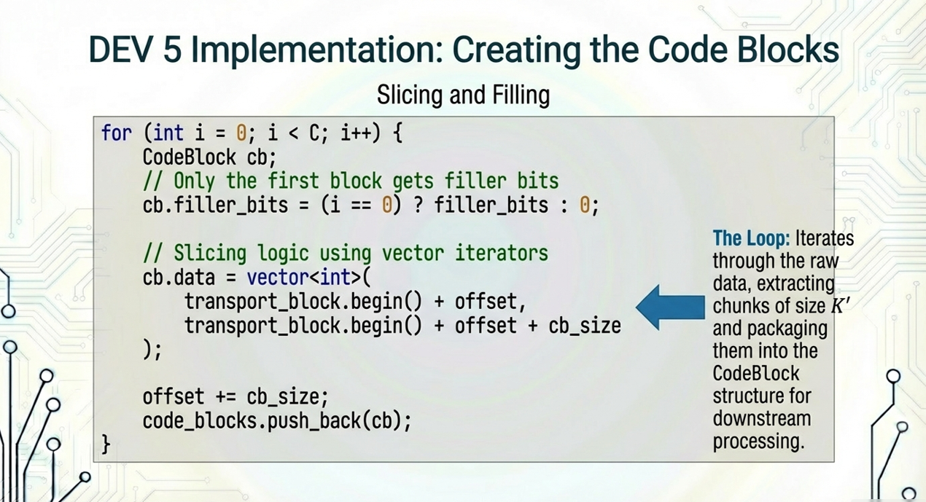
2024 - RPS Consulting all rights reserved

Slide 19
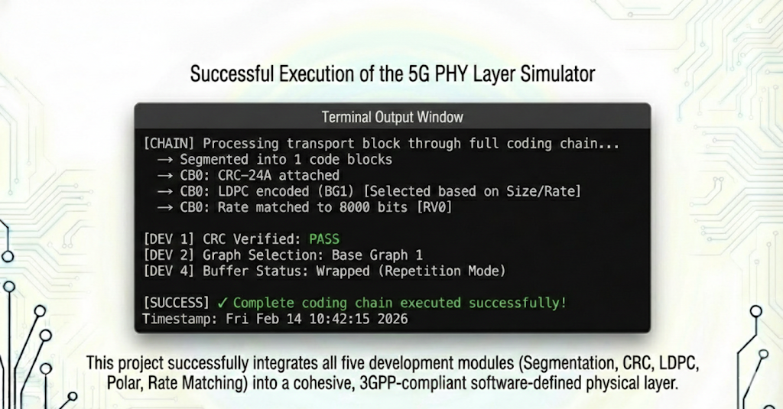
2024 - RPS Consulting all rights reserved

Slide 20
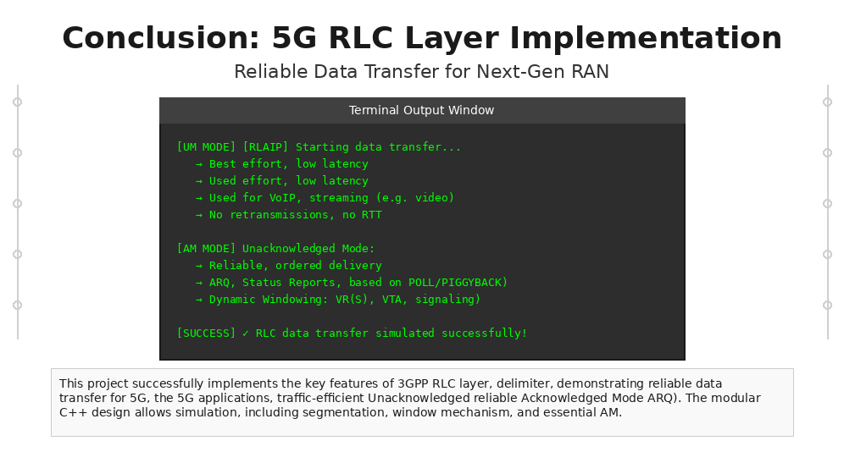
2024 - RPS Consulting all rights reserved

